Slide 1


for Reproducible data wrangling
GenGen workshop
15.02.2023
What happens before the stats:
the power of R Tidyverse for
wrangling, cleaning, and exploring your data
Giulia Puntin │
@sPuntinGi
Image credit: Allison Horst
Notes:
Hi I’m Giulia … PhD corals MOs in Germany … visiting at CX lab
I love R and I’m happy to share my knowledge and experience
I know you all are probably very familiar with some coding language or program (and probably have used R before) so I tried to pick stuff that I think can be useful for everyone and applicable to different types of data
So let’s get started: R for … basically I want to stress the advantages of using R from the very beginning of your data analysis and I’m going to shpw how to execute common and useful operations/transformations

Slide 2
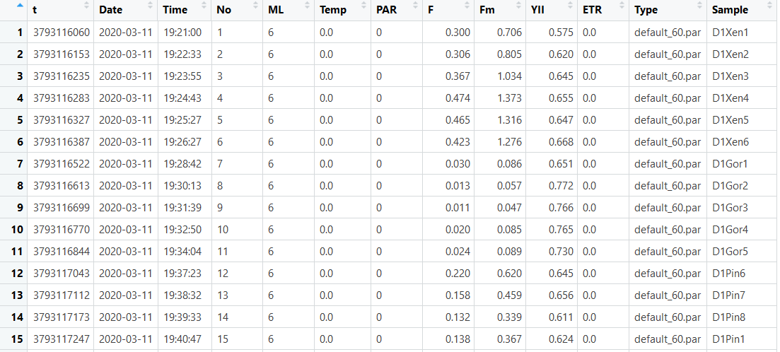
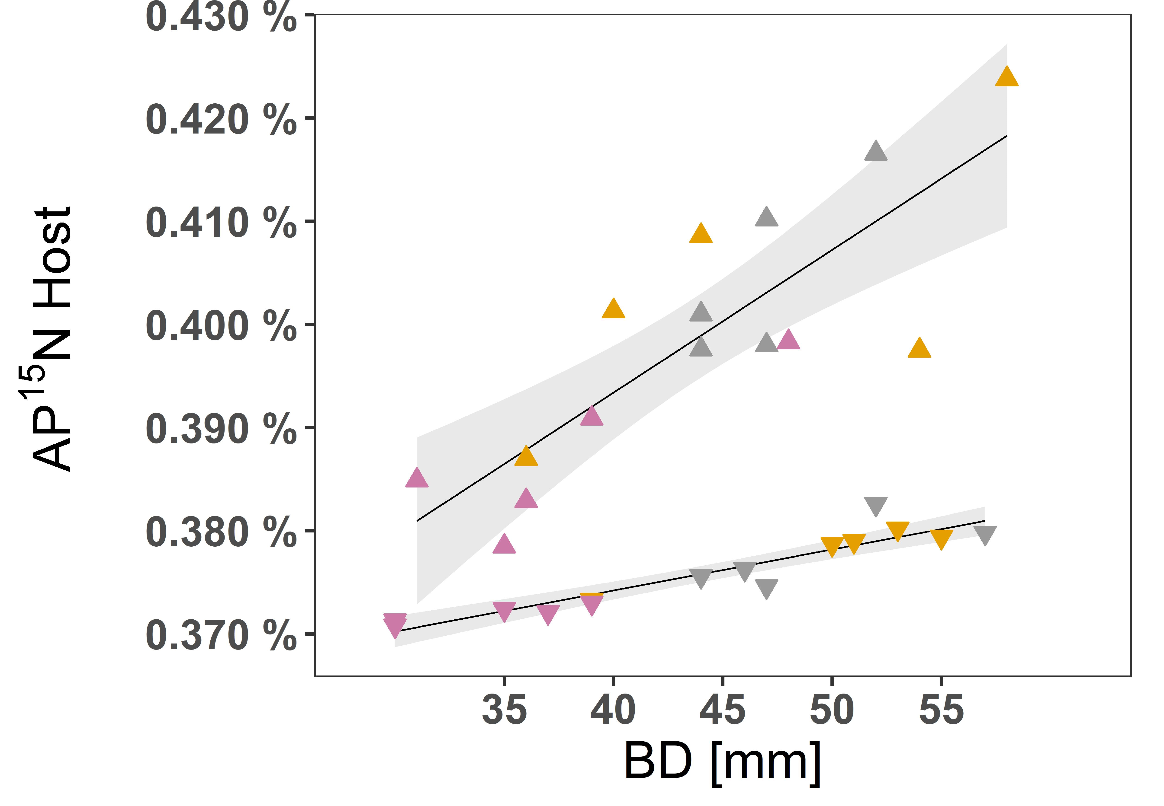

R is for “Reproducible”
Analyze the same data and obtain the same results
Data
Published results
Data analysis
script
Notes:
So let’s start by briefly defining it: simply put this can be summarized in the idea that by analysing the same data one should obtain the same results. Practically speaking, this means sharing the data as well as the details of how the data was analyzed.

Slide 3
R is for “Reproducible”
Analyze the same data and obtain the same results
In the paper
Data
Published results
Data analysis
script
In the supplementary material
(ideally … )
Notes:
Typically in a paper (scientific article) you have a general description of the statistical analysis (tests used, parameters etc) and the relevant results. Then in the SM you should have the actual data and scripts to perform the analysis (can be in R, but can also be other languages). (Ideally … coz in reality doesn’t always happen … but yeah, we aim to be that kind of shary scientists !).

Slide 4
R is for “Reproducible”
But there’s also that other part …
Data
Published results
Data analysis
script
Notes:
BUT, there is also another aspect to consider: the data that is ready to be analyses (do the stats) … was very likely not “born” in that way

Slide 5
R is for “Reproducible”
Cleaned data
ready for stats
But there’s also that other part …
Data
Published results
Data analysis
script
Notes:
BUT, there is also another aspect to consider: the data that is ready to be analyses (do the stats) … was very likely not “born” in that way

Slide 6
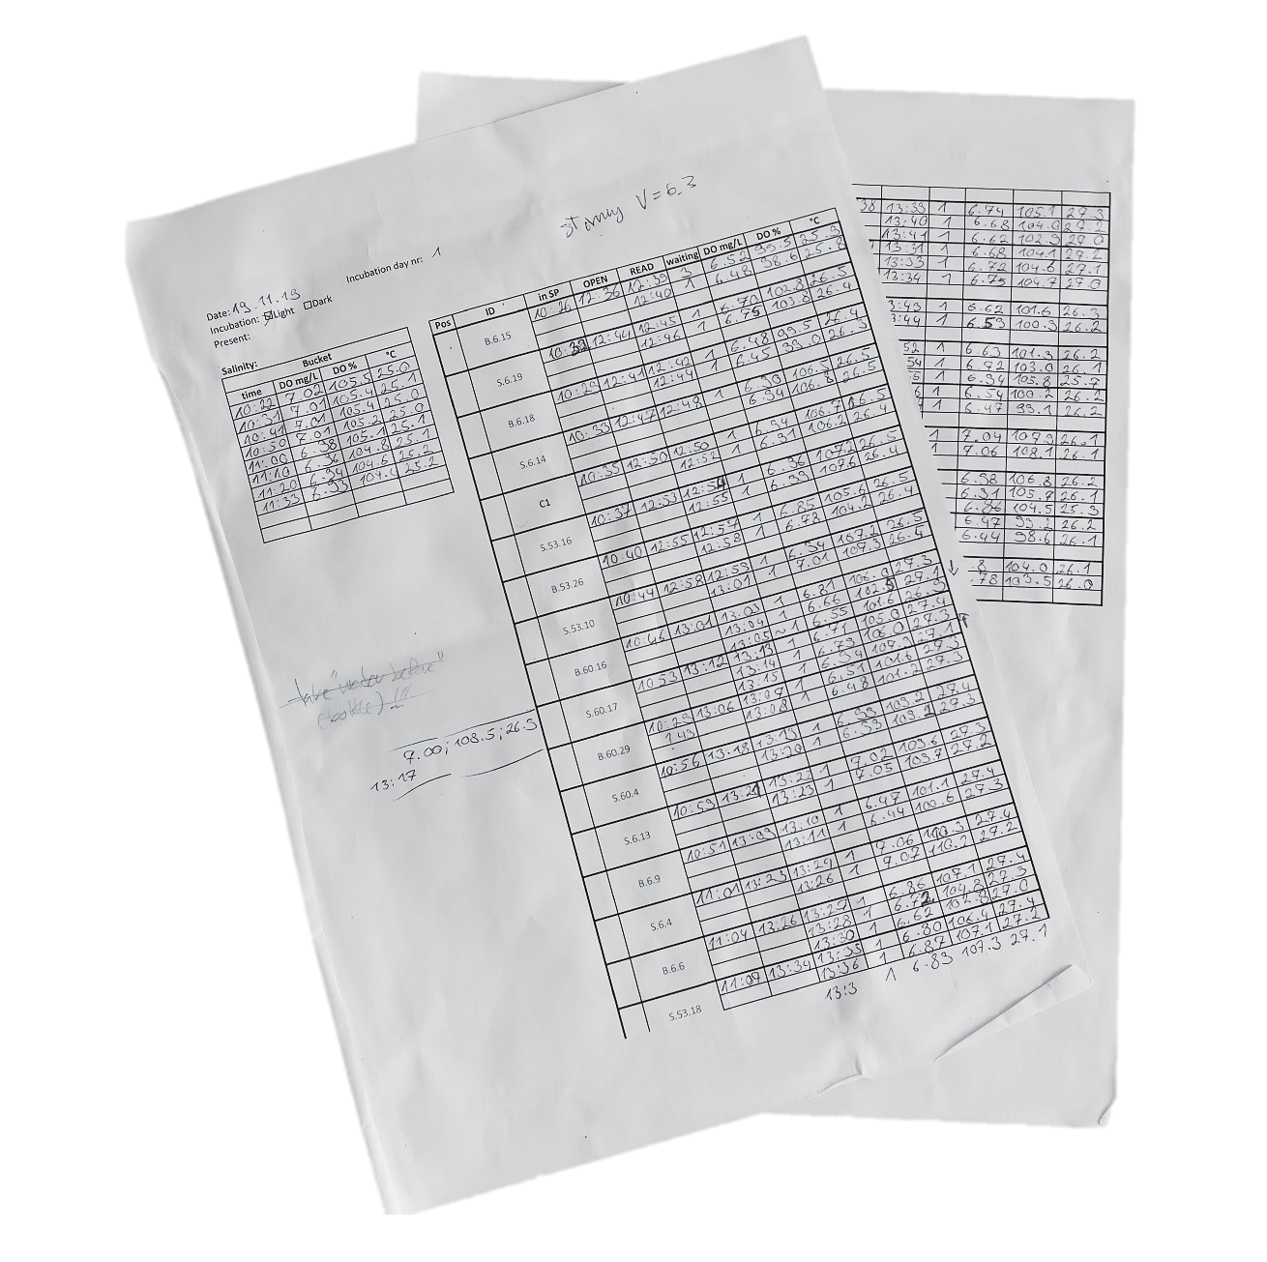

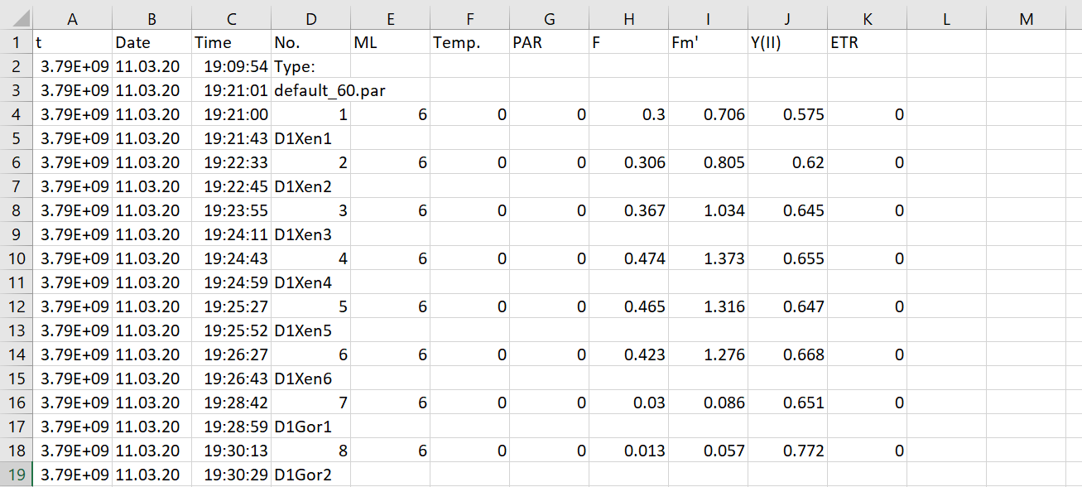

R is for “Reproducible”
Original data
original outputs
Cleaned data
ready for stats
hand notes
Published results
Data
wrangling
digitalize
Data analysis
script
Notes:
In most cases (at least in my experience), this is a more realistic situation! Data comes from different sources and in different shapes.
Data can be originally collected as hand written notes, or come already in a digital format … But it’s still not ready to be used.
This because you need to check for examples that the samples are named correctly (spelling), or that the tables are in the right shape and also you probably want to join separate tables into a single one and maybe even add extra information that might be stored in a separate file/table.

Slide 7



Unusable format …
… ready to be analyzed ☺
https://pokingcorals.blog/r-to-reshape-pam-csvs/
Notes:
For example, this is a real example of data that comes already in digital (table) format, but it requires some proper re-shaping before it can be used for anything

Slide 8
R is for “Reproducible”
Original data
original outputs
Cleaned data
ready for stats
hand notes
Published results
Data
wrangling
digitalize
Data analysis
script
Often overlooked/underestimated:
Not systematically taught (missing from typical R courses)
badly done (= NOT reproducible)
Time consuming (can take up as more time than stat testing)
=> sensitive step that can benefit a lot from improvement
Notes:
This is called “data wrangling” and I want to talk about it because this part is surprisingly often overlooked => 1. badly done and 2. can take up as much time as the statistical data analysis (if not more) = sensitive step that can benefit a lot form improvement.
What I mean with overlooked/underestimated is that during students training there is a lot of focus on learning R for stats and making plots, but very rarely (if ever) the part before is given any attention. You’re somehow supposed to figure it out by yourself. Which I don’t think is a very effective approach … because what people do is to use what seems “easier” to do

Slide 9

R is for “Reproducible”
Original data
original outputs
Cleaned data
ready for stats
hand notes
Published results
Data
wrangling
digitalize
Data analysis
script
Notes:
So what happens is that most people (especially R beginners – but not only!) use what they are already familiar with: spreadsheets (excel). Which looks user friendly but is not great for reproducibility!
While are necessary for digitalizing data (manually write into cells …), that’s it.

Slide 10
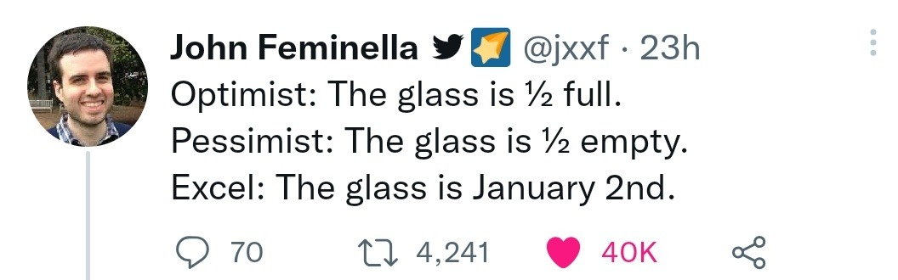
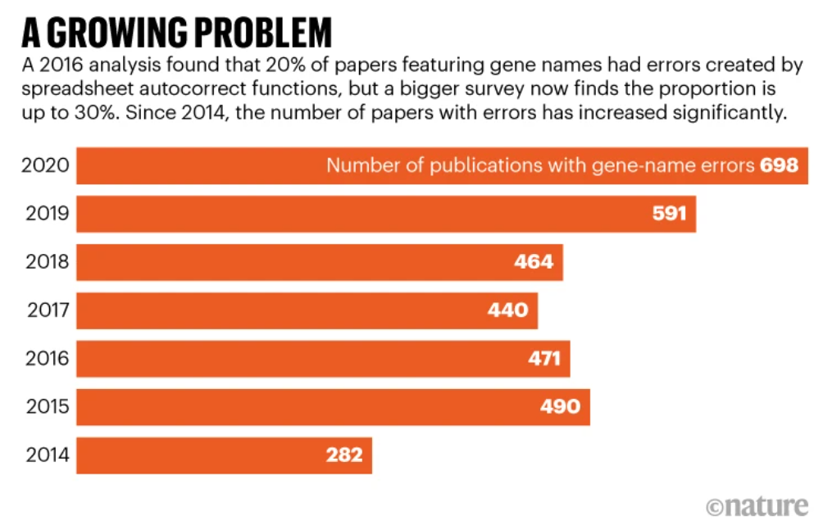
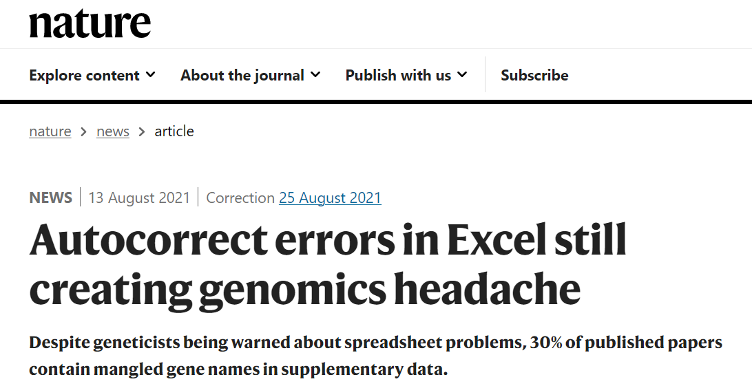
Beware of spreadsheets …
Problems derived from working with spreadsheets:
Messy (many files) …
Error prone (e.g. genuine mistakes + autocorrection … )
Not scalable (it just doesn’t work with large data sets)
Not reproducible (hard to keep track of every action)
On the contrary, by working in R, you can do everything without ever altering the original data!
(which also means that you can change your mind and easily un-do and re-do any operation)
Notes:
Also, data wrangling in spreadsheets comes with other limitations besides the messiness …

Slide 11
Beware of spreadsheets …
Problems derived from working with spreadsheets:
Messy (many files) …
Error prone (e.g. genuine mistakes + autocorrection … )
Not scalable (it just doesn’t work with large data sets)
Not reproducible (hard to keep track of every action)
On the contrary, in R, you can do everything without ever altering the original data!
(which also means that you can change your mind and easily un-do and re-do any operation)
Notes:
Also, data wrangling in spreadsheets comes with other limitations besides the messiness …

Slide 12
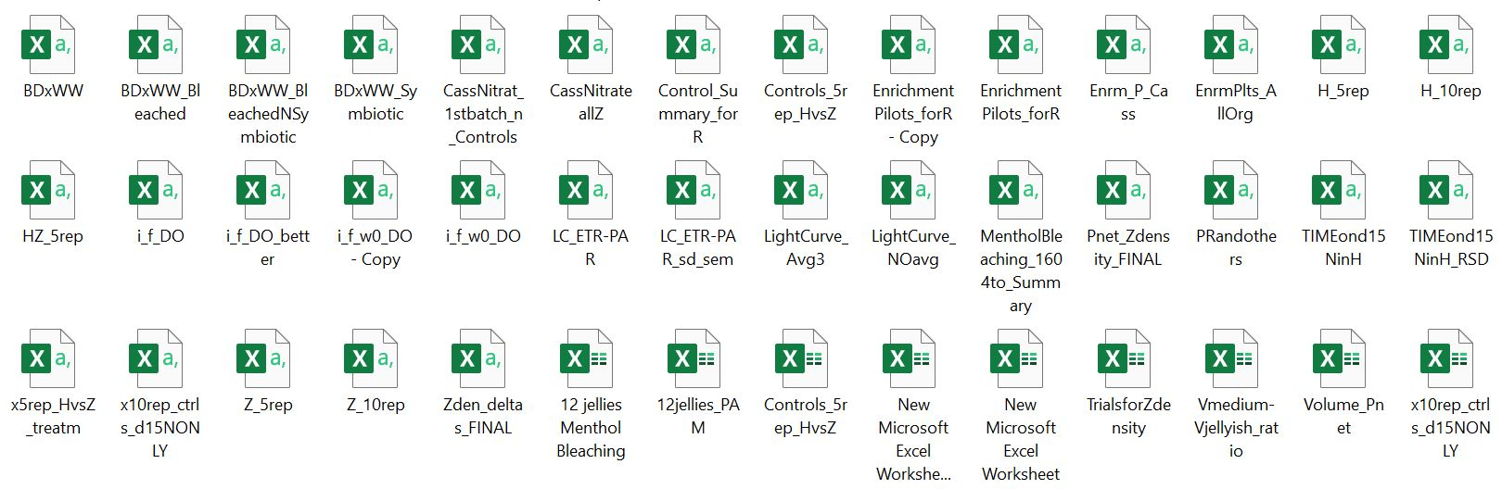
Old me before discovering Tidyverse …
Notes:
And I really speak for experience here (and that’s why I’m so invested in this workshop) because this is a screen shot of my folder of my MSc’s thesis. More than one year later I resumed it to prepare a publication and

Slide 13
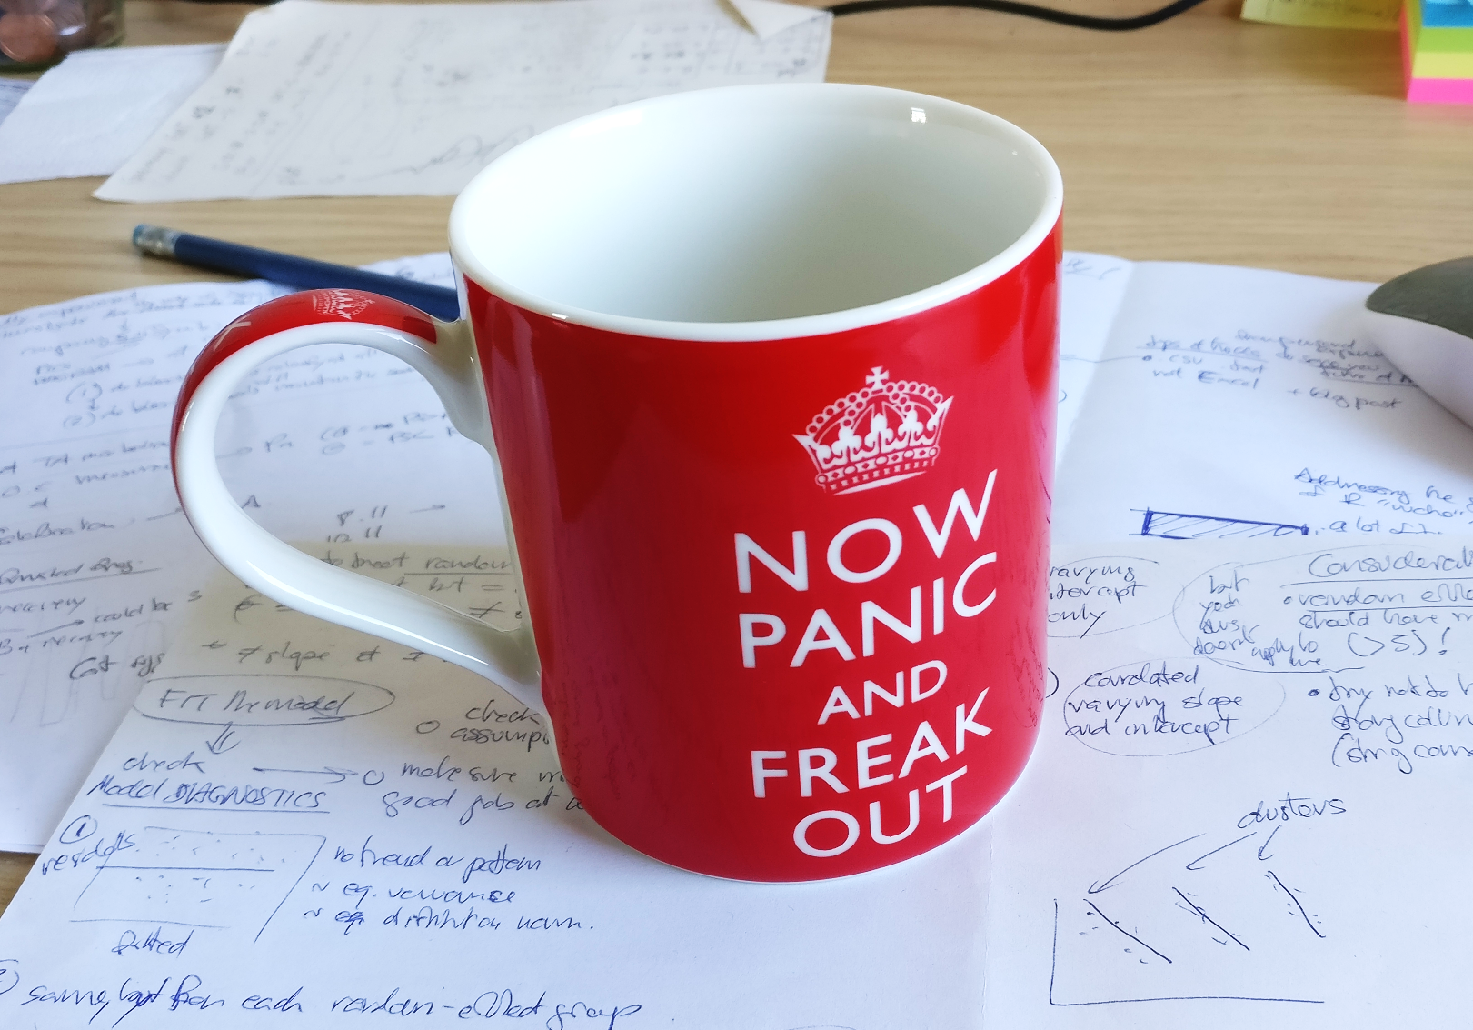
Old me before discovering Tidyverse …
Notes:
And I really speak for experience here (and that’s why I’m so invested in this workshop) because this is a screen shot of my folder of my MSc’s thesis. More than one year later I resumed it to prepare a publication and

Slide 14

R is for “Reproducible”
Original data
original outputs
Cleaned data
ready for stats
hand notes
Published results
Data
wrangling
digitalize
Data analysis
script
Notes:
So, I’m a great fan of pushing for R instead of excel!

Slide 15
R is for “Reproducible”
Original data
original outputs
Cleaned data
ready for stats
hand notes
Published results
Data
wrangling
digitalize
Data analysis
script
Notes:
So, I’m a great fan of pushing for R instead of excel!

Slide 16
R is for “Reproducible”
Original data
original outputs
Cleaned data
ready for stats
hand notes
Published results
Data
wrangling
digitalize
Data analysis
script
Reproducible data manipulation:
use R from the very beginning of your work with data
(not just for the stats and plots)!
Notes:
R for data wrangling! Particulalry, TIDYVERSE! (show later differences from base R)

Slide 17


What about ash/Uni and ?
Whatever gets the job done!
However, I recommend also implementing R in your analysis because:
“Safer” approach: R doesn’t modify data files directly, more wiggle room for trial and error (although disadvantages/additional steps)
Analyses are scripted: you can always go back and check exactly what you did
Convenience to have “all in one place”: seamlessly proceed with data visualization (ggplot!) and statistical testing
Deal with biologists: (unlike bioinformaticians) most biologists usually only know R …)
R vs Phyton:
Phyton: more versatile (ML, web dev op, …)
R: best for stats and data viz
Also, can just use both!
https://posit.co/blog/three-ways-to-program-in-python-with-rstudio/
Notes:
But also, you might be wondering … why not XXX ?

Slide 18

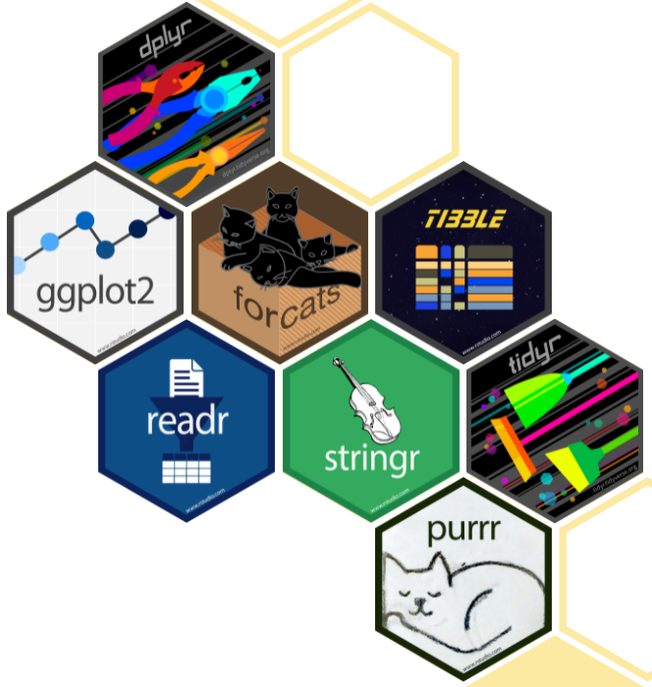
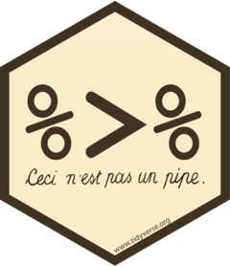
Tidyverse
A collection of R packages designed for data science, that share an underlying design philosophy, grammar, and data structures.
“A gateway drug.“
- my friend James
Noteworthy aspects:
Concept of “Tidy data”
The pipe (%>%) (more human readable than nested functions)
https://www.tidyverse.org/
Notes:
A collection of packages that do cool stuff (we’ll see soon) (e.g., ggplot2)

Slide 19
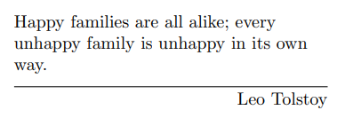
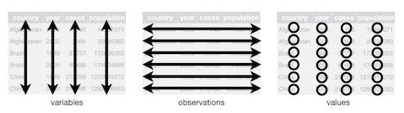
1. Tidy data
Simple rules:
Every column is a variable.
Every row is an observation.
Every cell is a single value.
12 Tidy data | R for Data Science (had.co.nz)
https://www.openscapes.org/blog/2020/10/12/tidy-data/
Wickham (2014)
Tidy Data | Journal of Statistical Software
Notes:
Seems obvious, right? What would you say about these three tables here, are they examples of tidy data?
Tricky, ah? Take your time to familiarize yourself with the concept, a great read is of course the material produced by Hadley Wickham … LINK
Is this a long or wide?

Slide 20
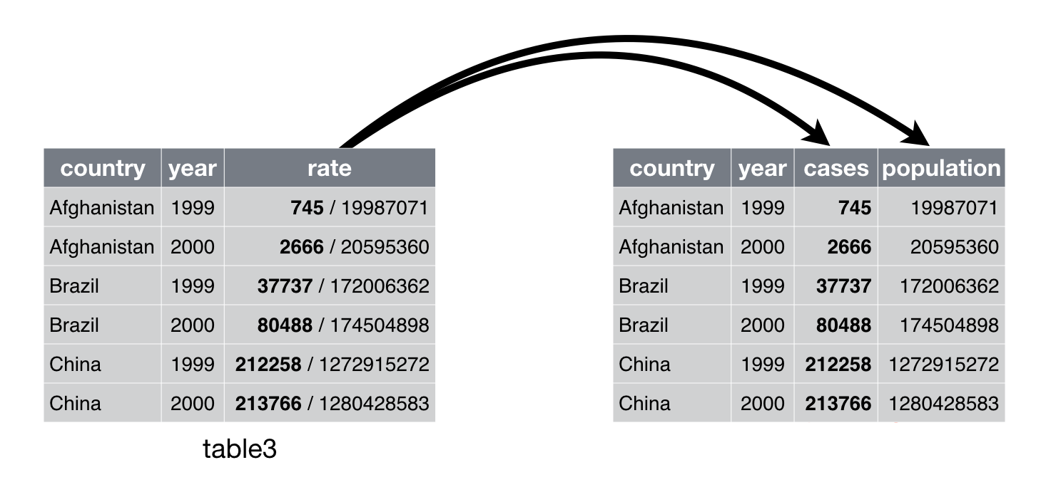
1. Tidy data
Simple rules:
Every column is a variable.
Every row is an observation.
Every cell is a single value.
12 Tidy data | R for Data Science (had.co.nz)
Wickham (2014)
Tidy Data | Journal of Statistical Software
Notes:
Seems obvious but not always

Slide 21


1. Tidy data
Simple rules:
Every column is a variable.
Every row is an observation.
Every cell is a single value.
12 Tidy data | R for Data Science (had.co.nz)
Wickham (2014)
Tidy Data | Journal of Statistical Software
Notes:
Seems obvious, right? Well, you’ll encounter many instances of non-tidy data, some more obvious than others. This one for examples is quite easy to spot as the “/” indicates two separate things ….
What would you say about these three tables here, are they examples of tidy data?
Tricky, ah? Take your time to familiarize yourself with the concept, a great read is of course the material produced by Hadley Wickham … LINK
Is this a long or wide?

Slide 22
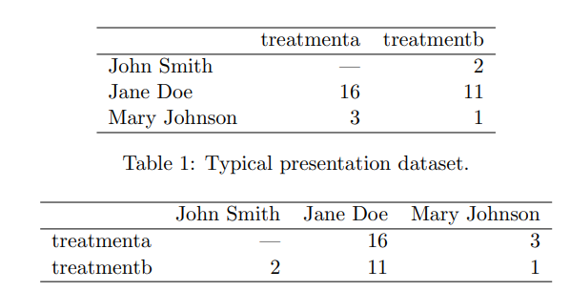
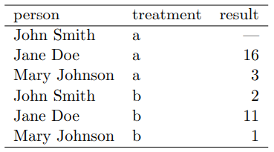
1. Tidy data
Simple rules:
Every column is a variable.
Every row is an observation.
Every cell is a single value.
12 Tidy data | R for Data Science (had.co.nz)
Wickham (2014)
Tidy Data | Journal of Statistical Software
Notes:
But this one might be a bit more tricky … only the rhs is actually in the tidy format
[Every value belongs to a variable and an observation. -> tip: the empty cell between rownames and colnames indicates non-tidy data …]

Slide 23
1. Tidy data
Simple rules:
Every column is a variable.
Every row is an observation.
Every cell is a single value.
12 Tidy data | R for Data Science (had.co.nz)
“wide”
“long”
“wide”
Wickham (2014)
Tidy Data | Journal of Statistical Software
Notes:
But this one might be a bit more tricky …
Tricky, ah? Take your time to familiarize yourself with the concept, a great read is of course the material produced by Hadley Wickham … LINK
Is this a long or wide?
[Every value belongs to a variable and an observation. -> tip: the empty cell between rownames and colnames indicates non-tidy data …]

Slide 24


1. Tidy data
Simple rules:
Every column is a variable.
Every row is an observation.
Every cell is a single value.
12 Tidy data | R for Data Science (had.co.nz)
Only column names
Colum names
Row names
Tidy
Not tidy
Wickham (2014)
Tidy Data | Journal of Statistical Software
Notes:
Also a quick way to tell if data is non-tidy is when you have row names …
BUT don’t worry if this is not clear yet: you’ll easily learn by doing!

Slide 25
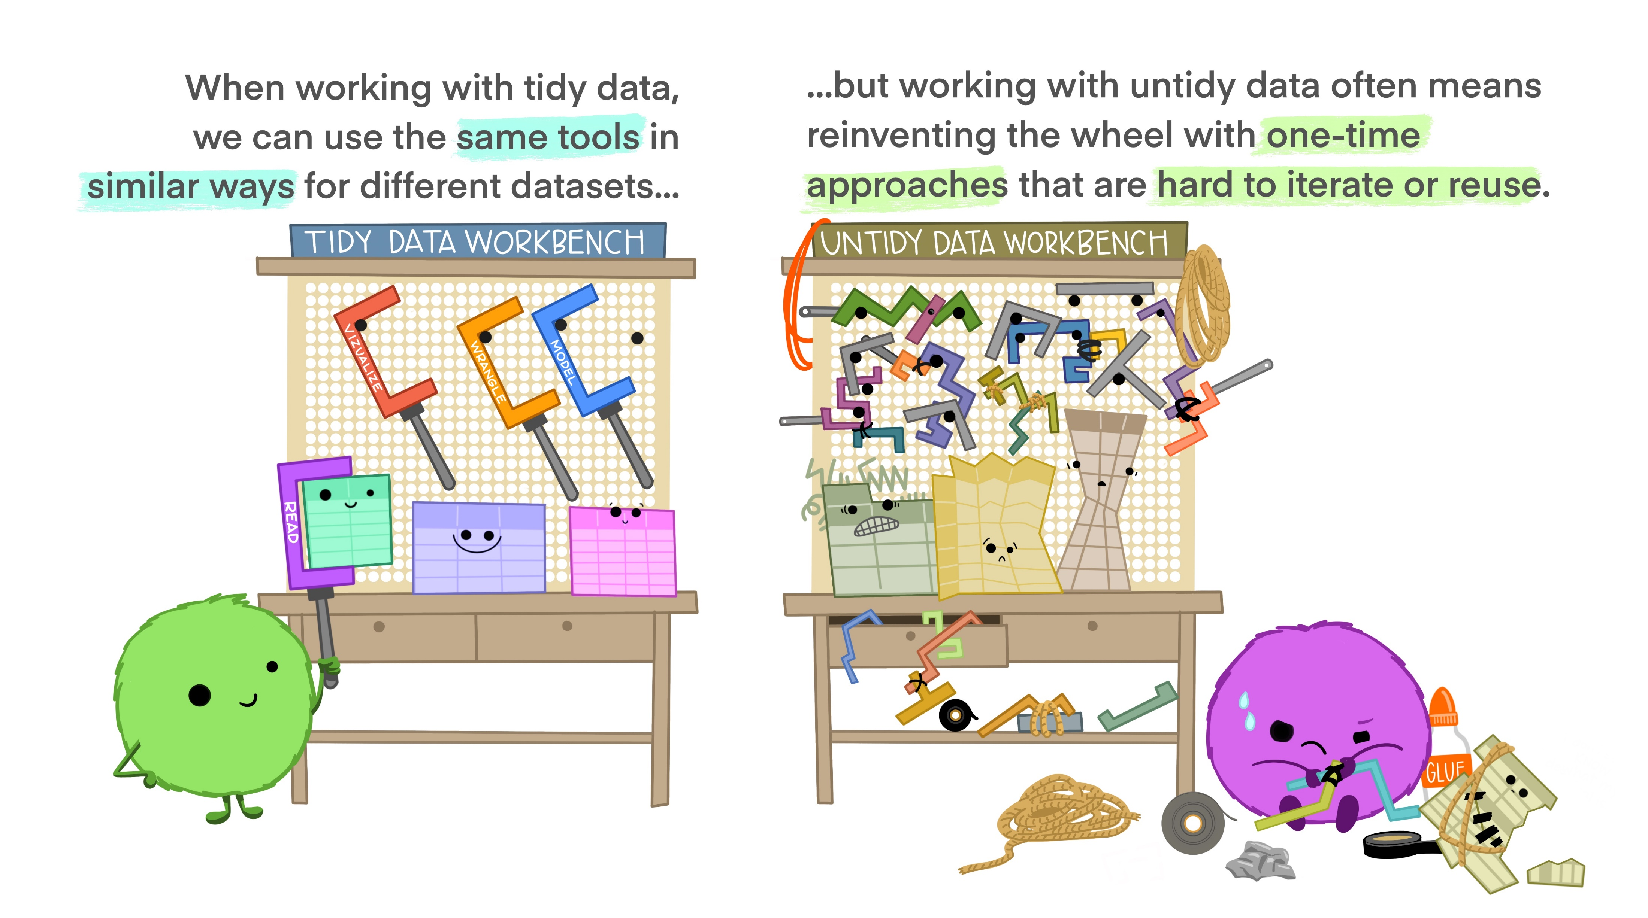
Credit: Allison Horst
Notes:
So why is this tidy format so important? Because it makes work easier! You can use the same tools or approaches for any type of data

Slide 26
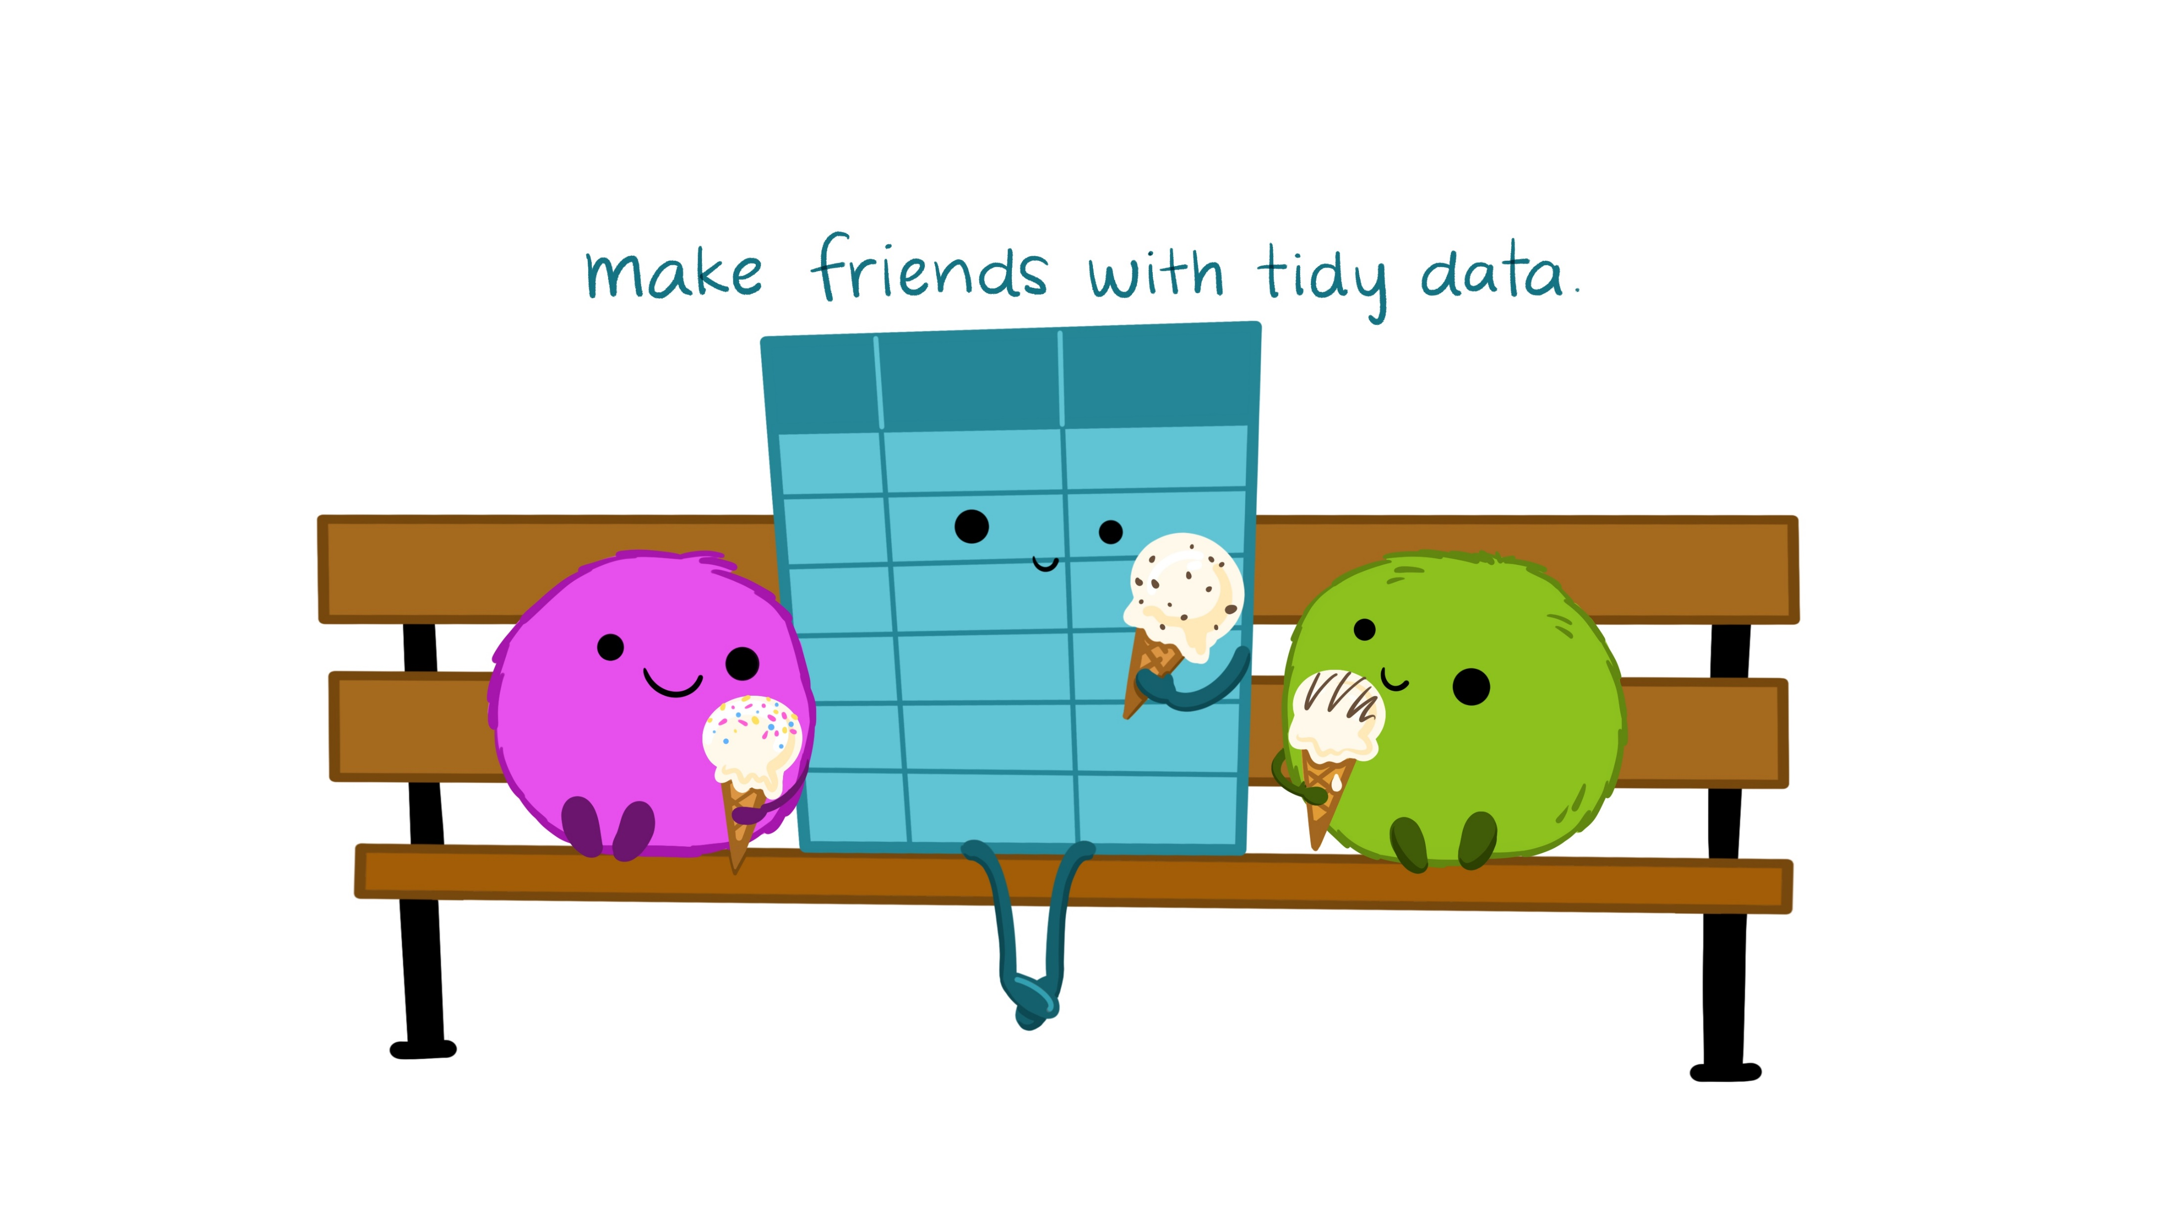
Credit: Allison Horst

Slide 27
2. Piping functions (vs nested)
Nested functions (base R)
length(unique(data$variable)))
Using the pipe makes the code easier to write and to read (Tidyverse)
data$variable %>% unique() %>% length()
3
2
1
1
2
3

Slide 28
2. Piping functions (vs nested)
A more complex example of piping (from this workshop script):
data %>%
group_by(Species, Sex, Island) %>%
summarise(across(where(is.numeric), ~ mean(.x, na.rm = TRUE))) %>%
select(-Sample_Number) %>%
arrange(desc(Sex)) %>%
write_csv(., "./out/data_means.csv")
No need to create intermediate objects, just pipe the outcome of one function into the next
(use “.” as placeholder)

Slide 29

String manipulation stringr::str_*()
Work with character strings (text)
Uses regex (regular expressions): a “codified” way to describe patterns in text strings, to do things with them (extract, select, replace, … )
Same rules as `grep` or `sed’ in Unix and Bash
“d__Bacteria; p__Proteobacteria; c__Gammaproteobacteria; o__Pseudomonadales; f__Moraxellaceae; g__Acinetobacter”
“d__Bacteria; p__Proteobacteria; c__Gammaproteobacteria; o__Pseudomonadales; f__Moraxellaceae; g__Acinetobacter”
“d__Bacteria; p__Proteobacteria; c__Gammaproteobacteria; o__Pseudomonadales; f__Moraxellaceae; g__Acinetobacter”
Notes:
14.7 stringi
stringr is built on top of the stringi package. stringr is useful when you’re learning because it exposes a minimal set of functions, which have been carefully picked to handle the most common string manipulation functions. stringi, on the other hand, is designed to be comprehensive. It contains almost every function you might ever need: stringi has 256 functions to stringr’s 49.
If you find yourself struggling to do something in stringr, it’s worth taking a look at stringi. The packages work very similarly, so you should be able to translate your stringr knowledge in a natural way. The main difference is the prefix: str_ vs. stri_.

Slide 30
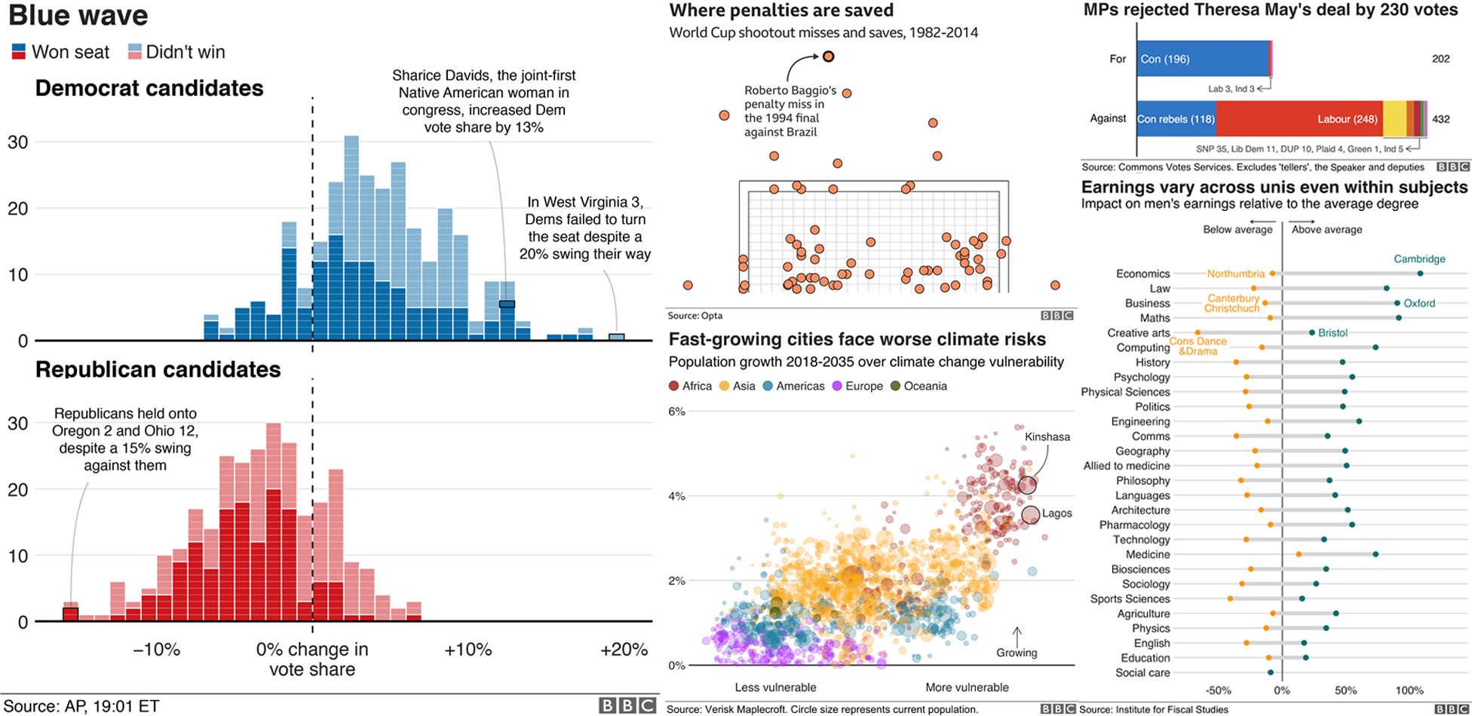
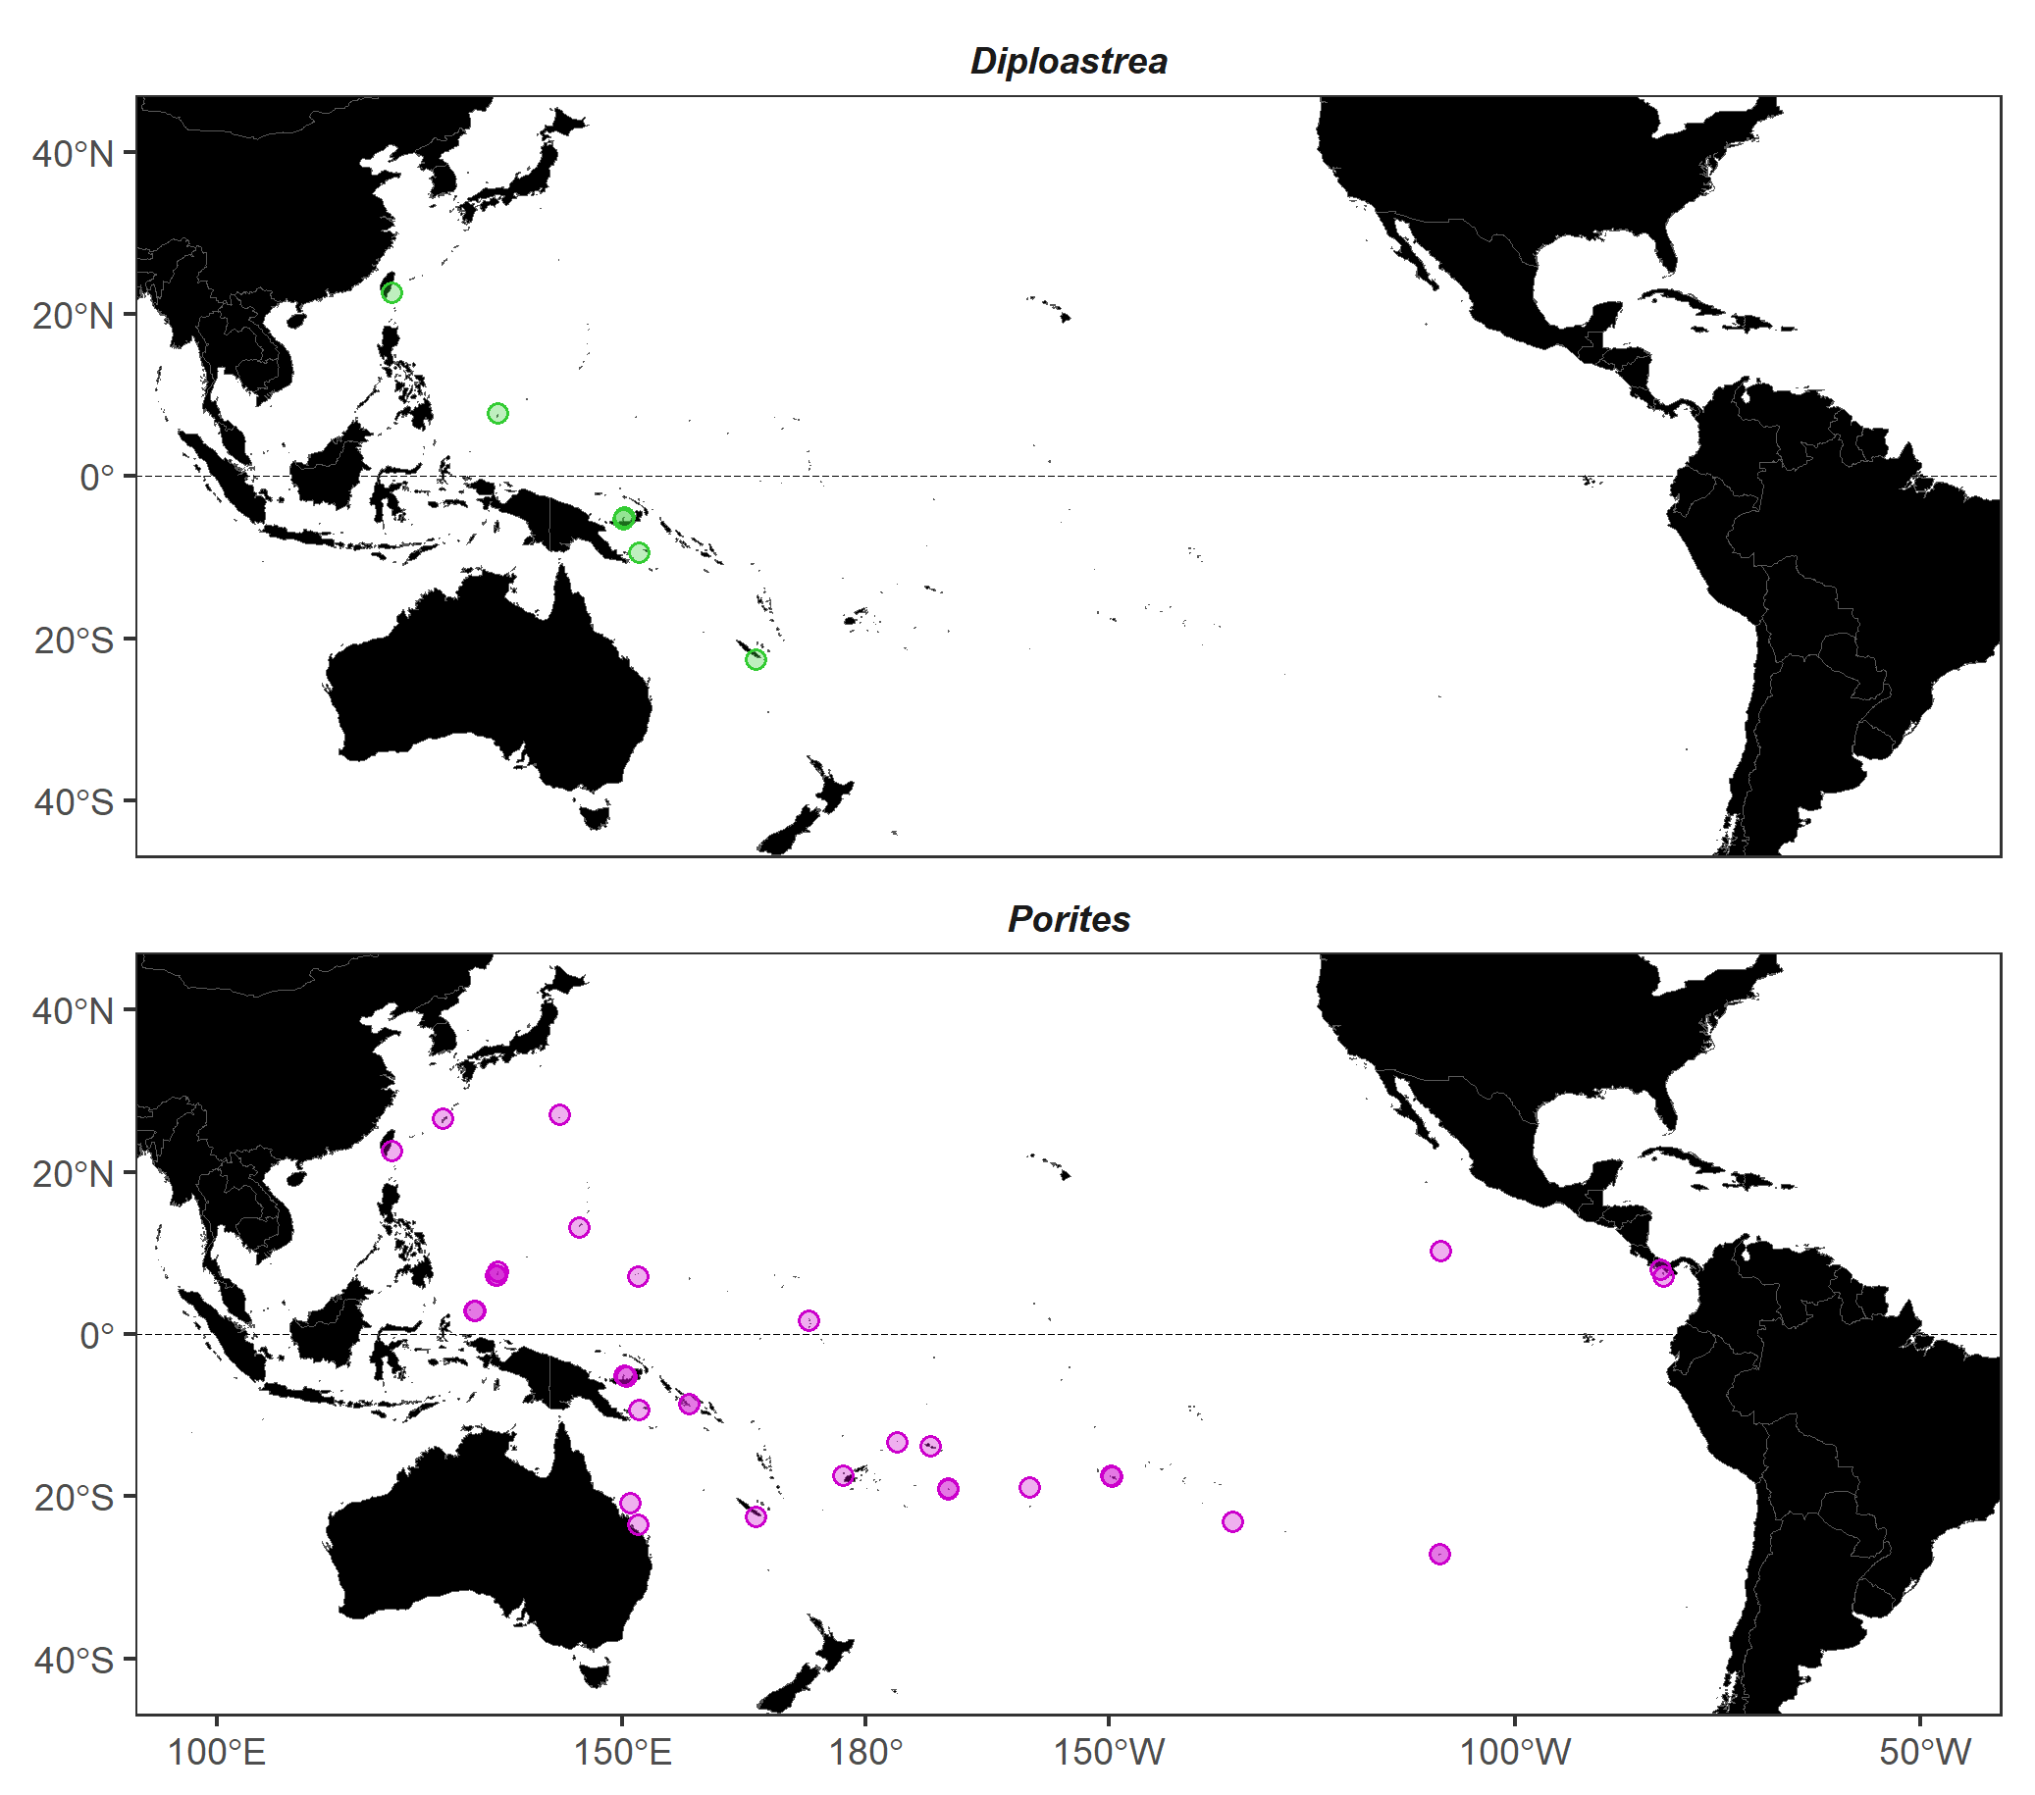
Data Viz with ggplot
Publication quality (also BBC, Economist …)
Also just super beautiful:
Cedric Scherer: https://www.cedricscherer.com/2019/08/05/a-ggplot2-tutorial-for-beautiful-plotting-in-r/ website LINK
R graph gallery
Notes:
BBC uses ggplot (there’s even a package: “bbplot”)

Slide 31
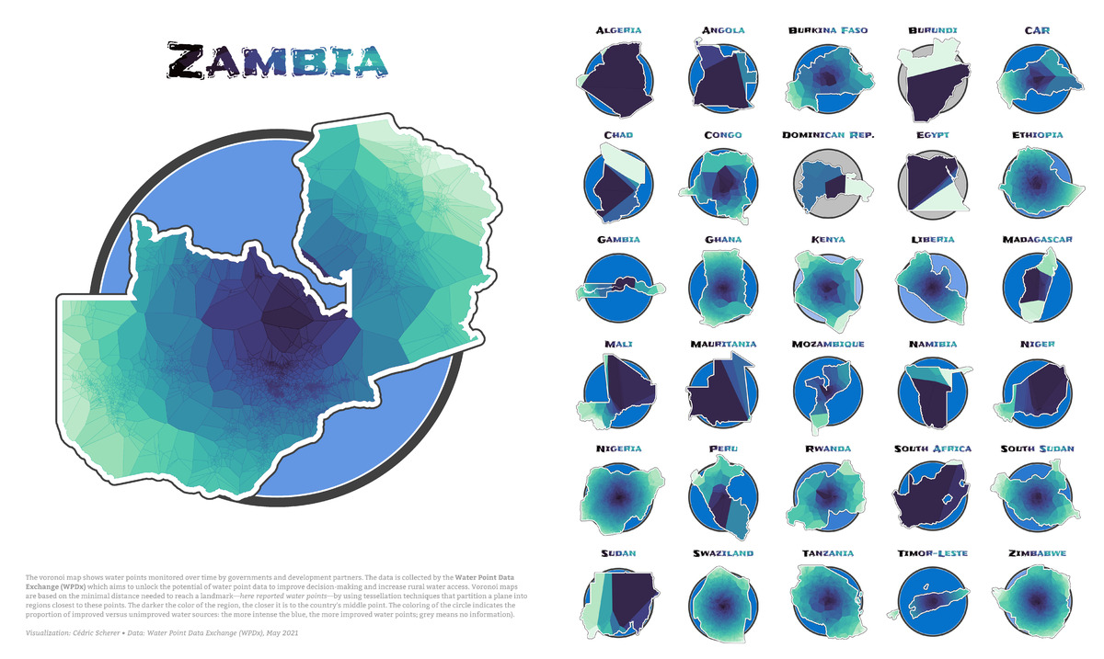
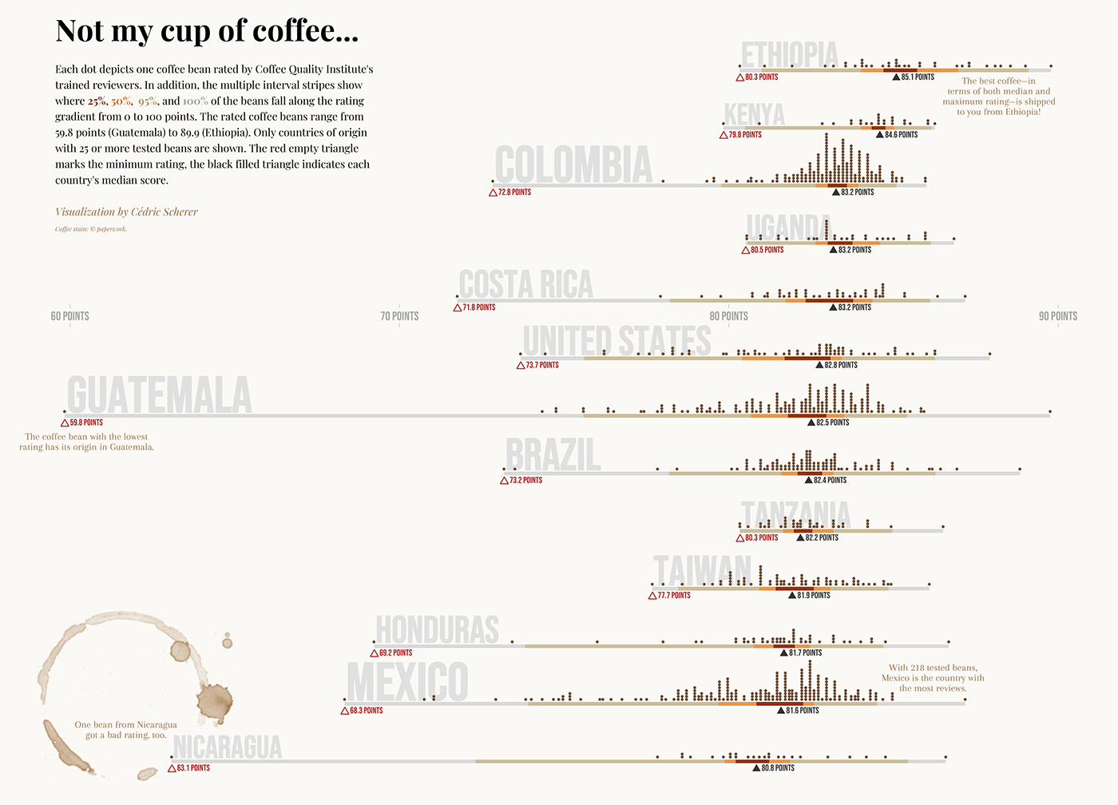
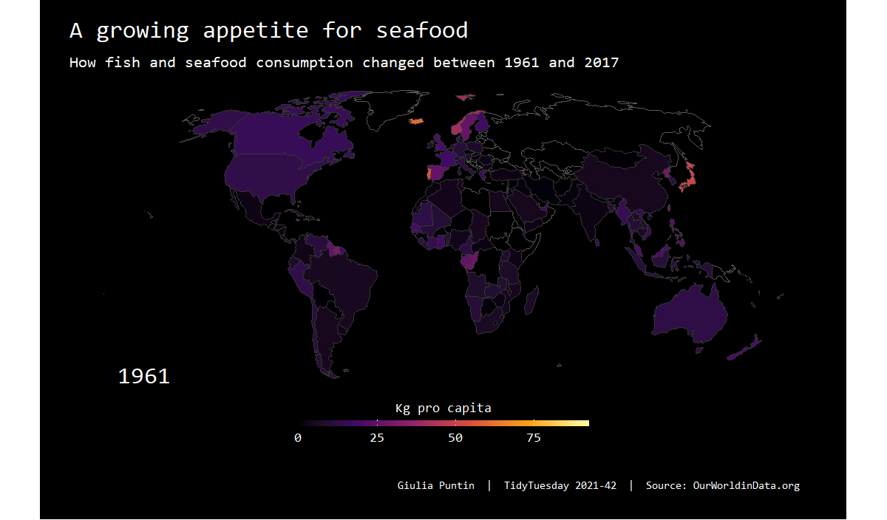
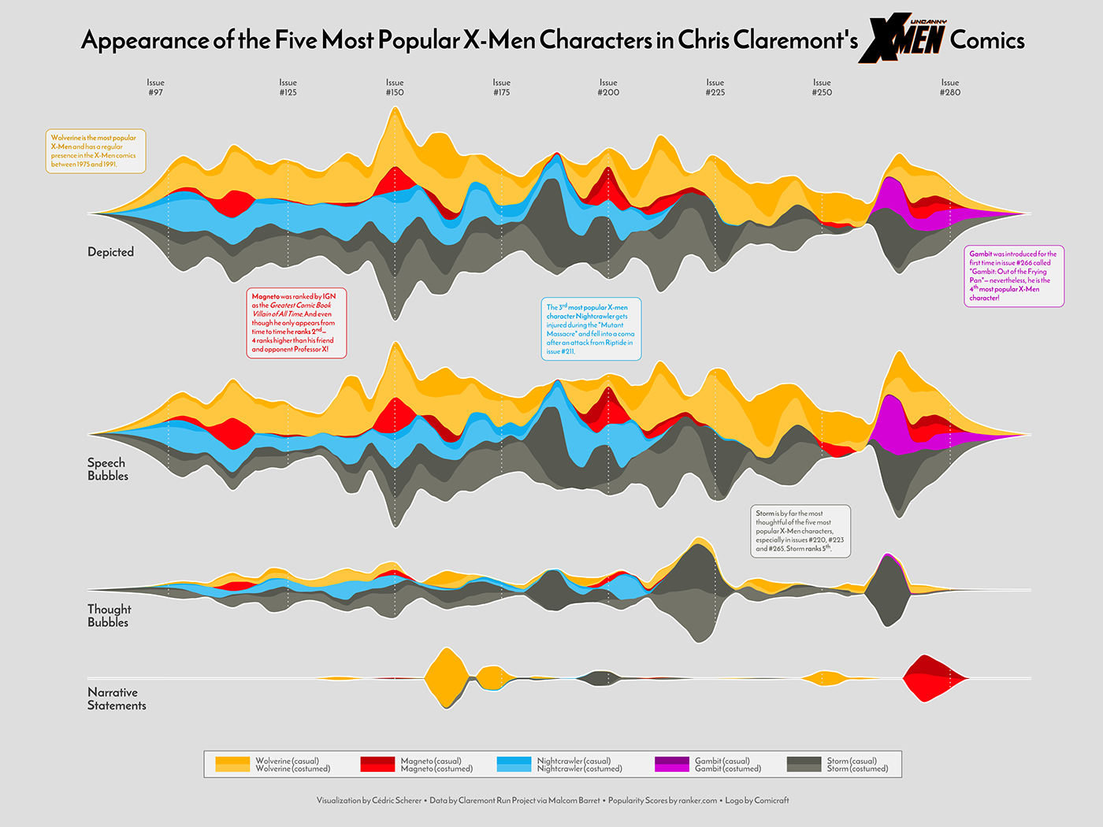
Data Viz with ggplot
Publication quality (also BBC, Economist …)
Also just super beautiful:
Cedric Scherer tutorial blog
R graph gallery
#TidyTuesday

Slide 32

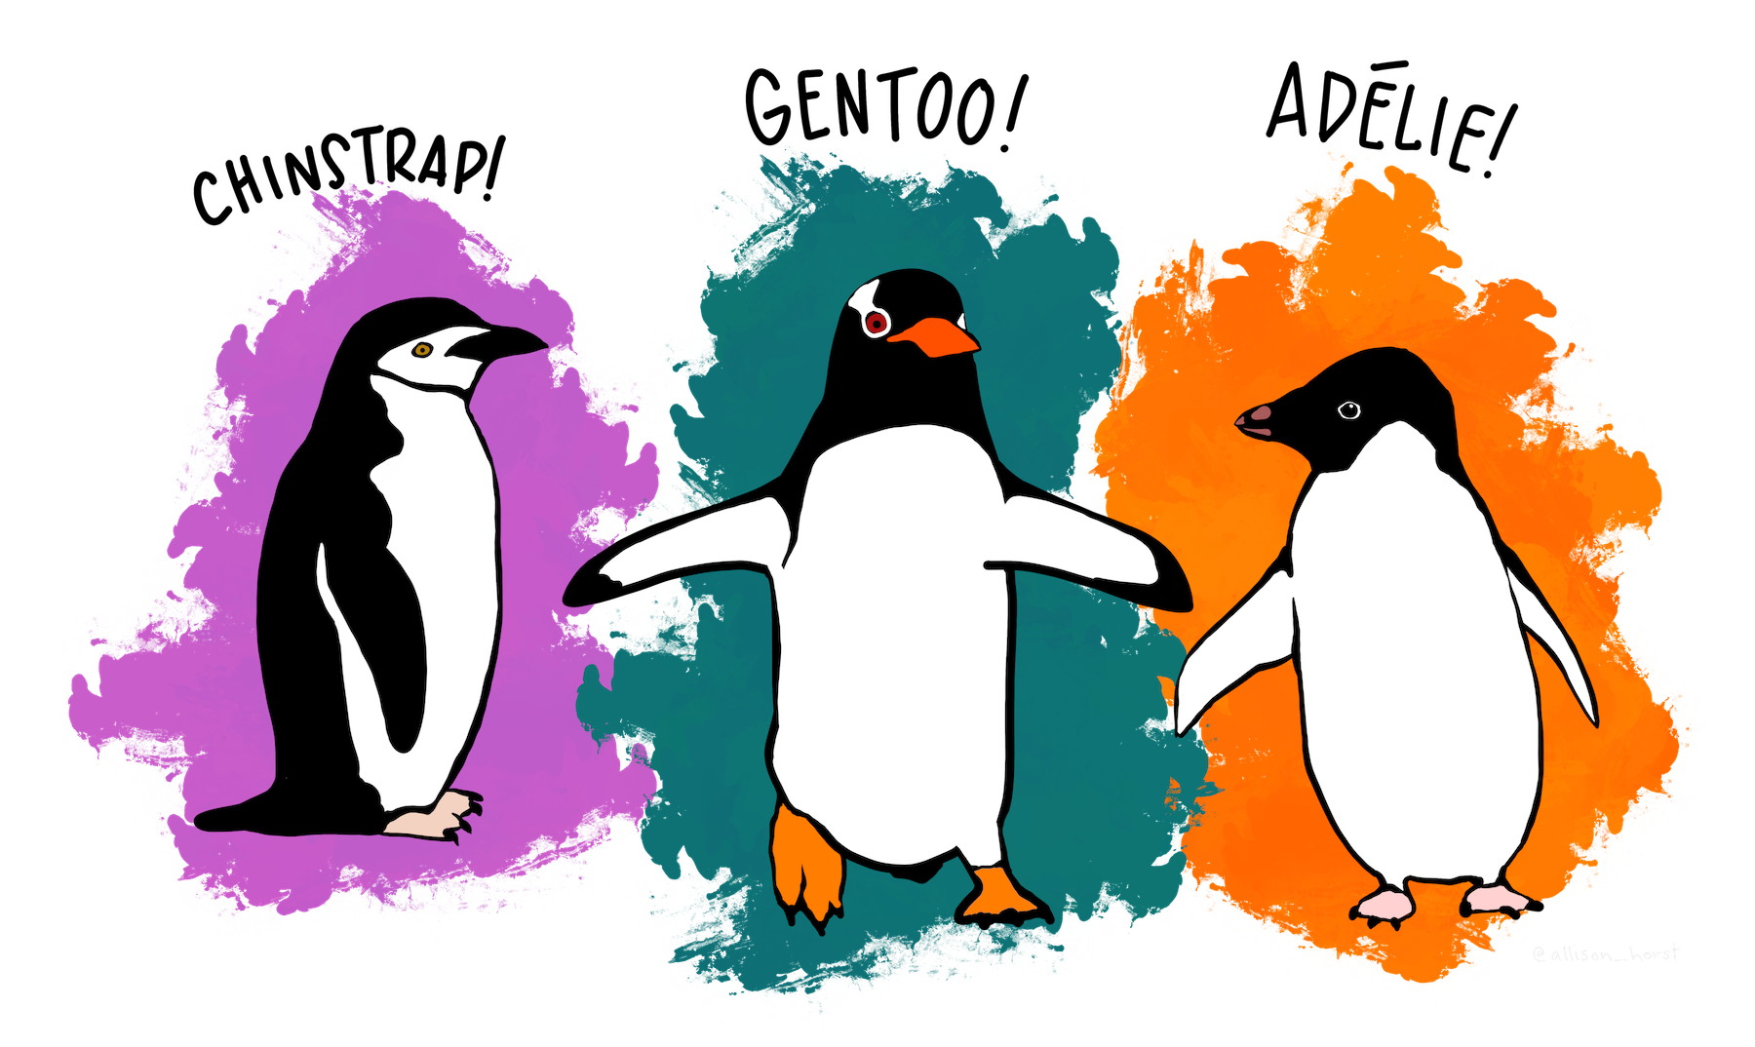
Overview of the data set
Practical part: R and Tidyverse in action!
The R script is based on dummy data
(modified from open data set for didactic purposes by me)
Data on penguins’ body dimensions, stable isotope measurements, and life stages by species, sex, location, etc
Chosen because of properties:
numeric data
character data and
big enough that it would be annoying to do in Excel
=> good for showing my favorite Tidyverse functions
Original data: palmerpenguins::penguins_raw
For more info: ?penguins_raw

Slide 33
Data wrangling
Transform raw data into another format that is more suited for downstream applications (e.g., analytics)
But briefly:
Create/modify variables
Subset data
Summarize
Re-shape: pivot_wider(), pivot_longer(), arrange()
Merge: *_join() … (e.g. left_join(), outer_join(), … )
Correct values: rename(), replace()
Plot like a pro: ggplot()
Notes:
Sorting/re-arranging of data (change order, transpose)
Sub setting/filtering (separate a smaller part of a dataset from the rest -> e.g., to plot, remove outliers)
Merging (put together data from different tables/sheets)
Correcting errors (e.g., typos)

Slide 34

Data wrangling
Transform raw data into another format that is more suited for downstream applications (e.g., analytics)
But briefly:
Create/modify variables: mutate()
Subset data: filter(), select()
Summarize: summarise(), group_by()
Re-shape: pivot_wider(), pivot_longer(), arrange()
Merge: *_join() … (e.g. left_join(), outer_join(), … )
Correct values: rename(), replace()
Plot like a pro: ggplot()
Use in combination with
if_else(), case_when(), %in%
Notes:
Sorting/re-arranging of data (change order, transpose)
Sub setting/filtering (separate a smaller part of a dataset from the rest -> e.g., to plot, remove outliers)
Merging (put together data from different tables/sheets)
Correcting errors (e.g., typos)

Slide 35
All workshop material
available at
https://github.com/sPuntinG/GenGen_Rworkshop2023

Slide 36
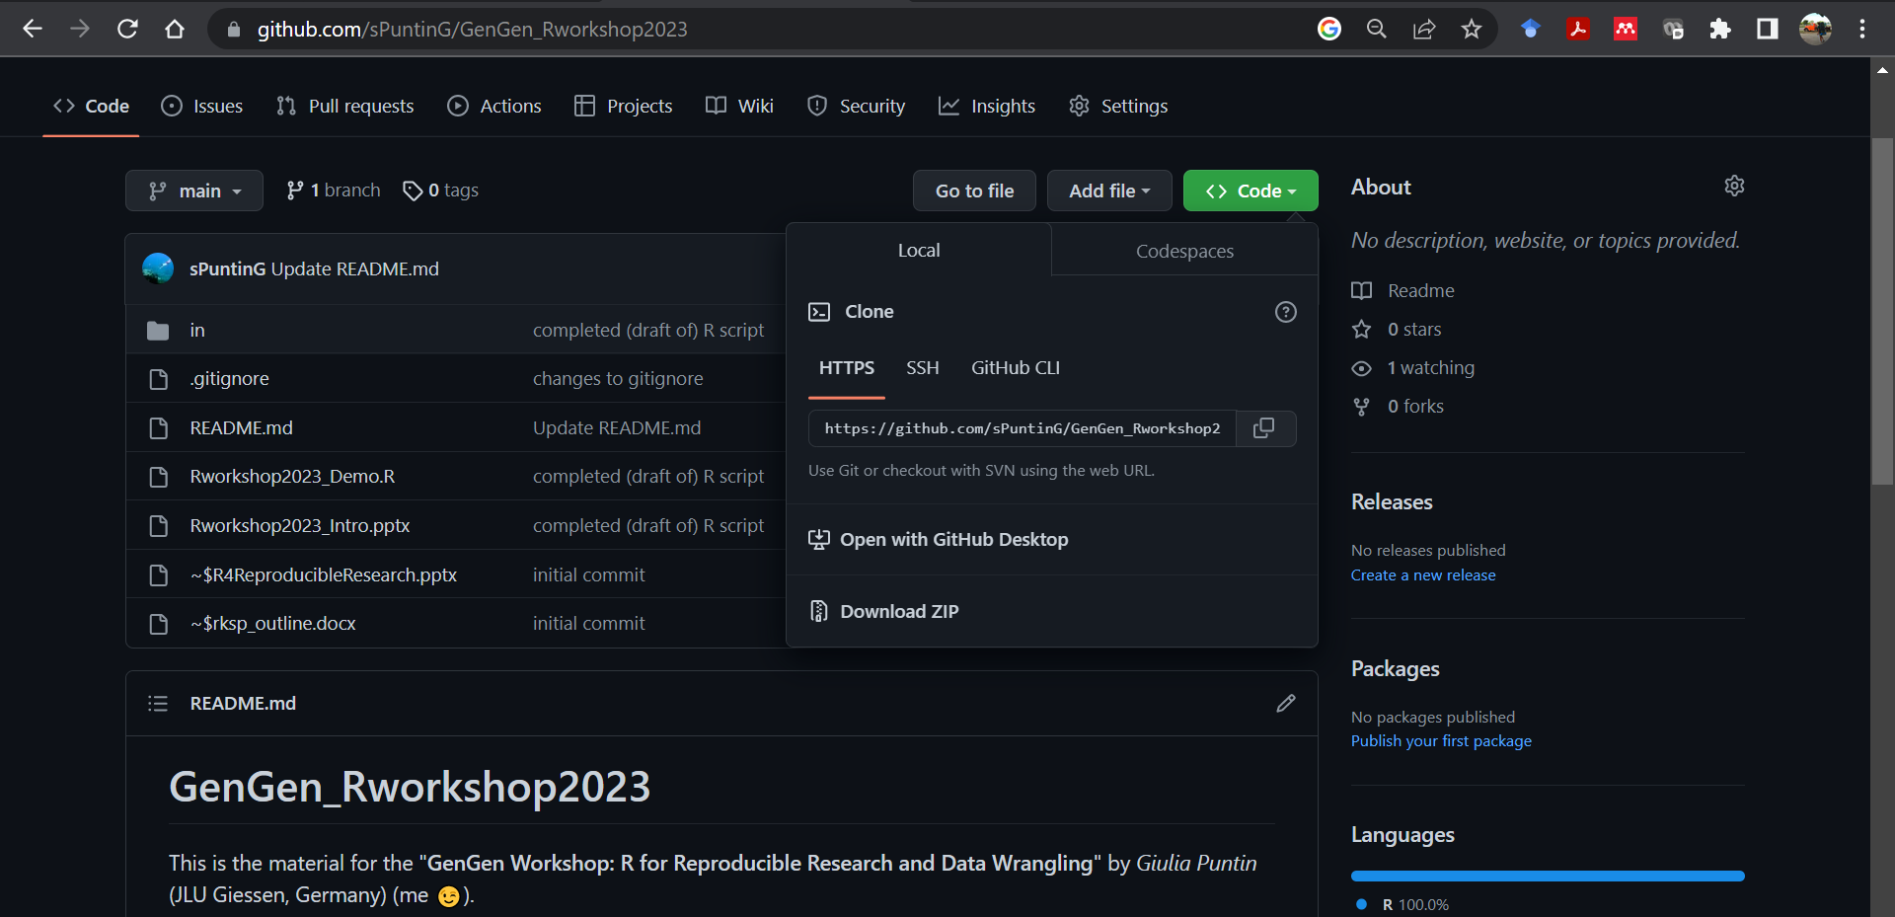

Slide 37
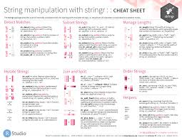
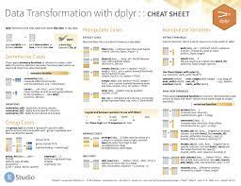
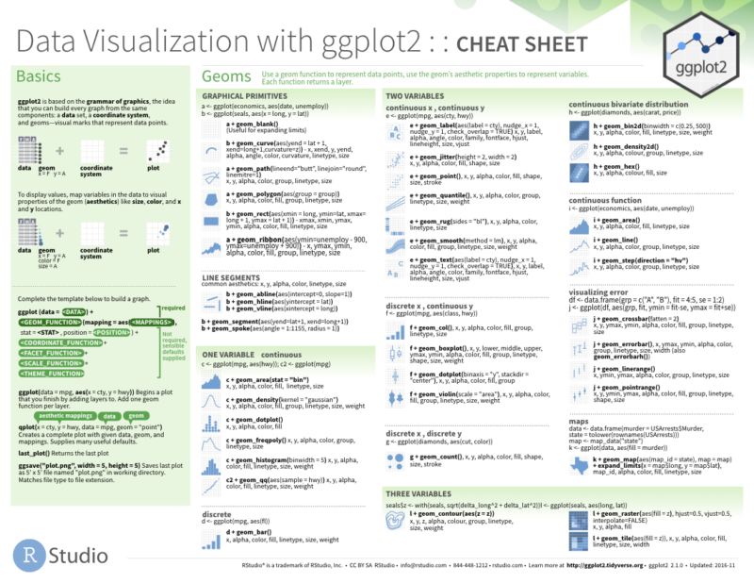
… and waaaay more!
This is just a short demonstration of what can be done (and how easily) in R Tidyverse,
BUT there’s so much more out there!
Recommend:
Today: ask me/us about specific tasks/operations that you’d like to learn to execute in R
Any time: Check out the package cheat sheets for inspiration (I used them a lot!)
https://posit.co/resources/cheatsheets/?type=posit-cheatsheets&_page=2/

